Slide 1
Graduation Evening

Slide 2
Award Recipients
Academic Achievement Award
Academic Improvement Award
Citizenship Award
Japanese Award
Physical Education Award
Visual Arts Award
Performing Arts Award
Music Award
The Lighthouse Award

Slide 3
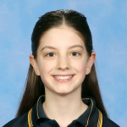
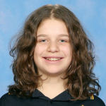
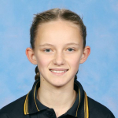
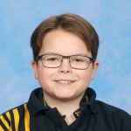
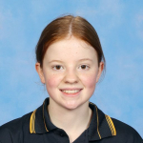
Academic Awards
Eva Cornish
Room 27
Alexis Panopoulos
Room 27
Leni Knowles
Room 27
Oliver Sale
Room 28
Andie Rosenberg
Room 27
Jacob Watson Room 29

Slide 4
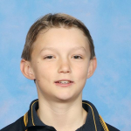
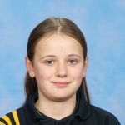
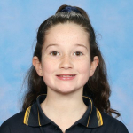
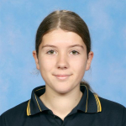
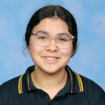
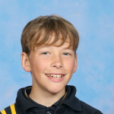
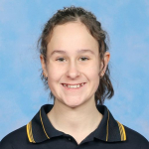
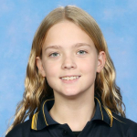
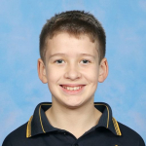
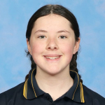
Academic Improvement Awards
Billy Rowston
Room 17
Charlotte Hollitt
Room 17
Chanelle O’Connor
Room 17
Danielle Markou
Room 27
Skala Heli
Room 27
Finn Gunton
Room 28
Bella Ursino
Room 28
Maisyn Harvey
Room 28
Ashton O’Neill
Room 29
Alexis Cox
Room 29

Slide 5
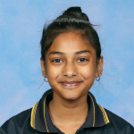
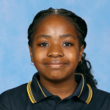
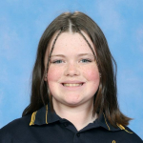
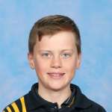
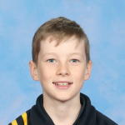
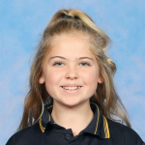
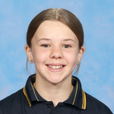
Citizenship Awards
Charlotte Hollitt
Room 17
Shyla Dutt
Room 27
Lizzy Pemhiwa
Room 27
Eva Cornish
Room 27
Finn Gunton
Room 28
Lillie Middleton
Room 28
Charlie Hayford
Room 28
Patrick Hayford
Room 28
Adilyn Anderson
Room 29
Alexis Cox
Room 29
Lily Beazley
Room 29

Slide 6
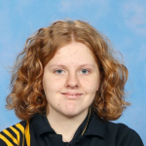
Japanese Awards
Eva Cornish
Room 27
Caprice Flink
Room 29

Slide 7
Physical Education Awards
Finn Gunton
Room 28
Leni Knowles
Room 27

Slide 8
Visual Arts Awards
Skala Heli
Room 27
Caprice Flink
Room 29

Slide 9
Performing Arts Award
Alexis Cox
Room 29

Slide 10
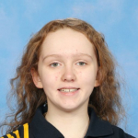
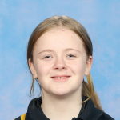
Music Awards
Kalea Fairbairn
Room 17
Emily Bakhuis
Room 29

Slide 11
Lighthouse Award
Finn Gunton
Room 28

